Slide 1
Energy of a System & Conservation of Energy

Slide 2
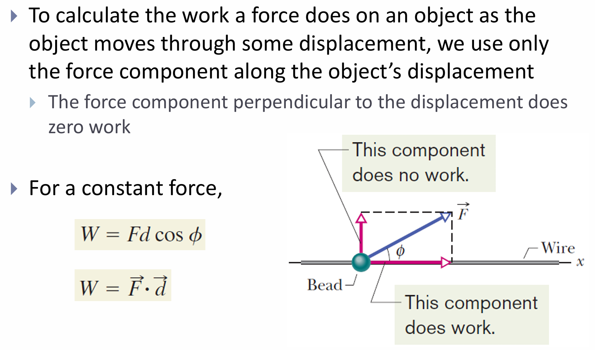
Work and Kinetic Energy

Slide 3
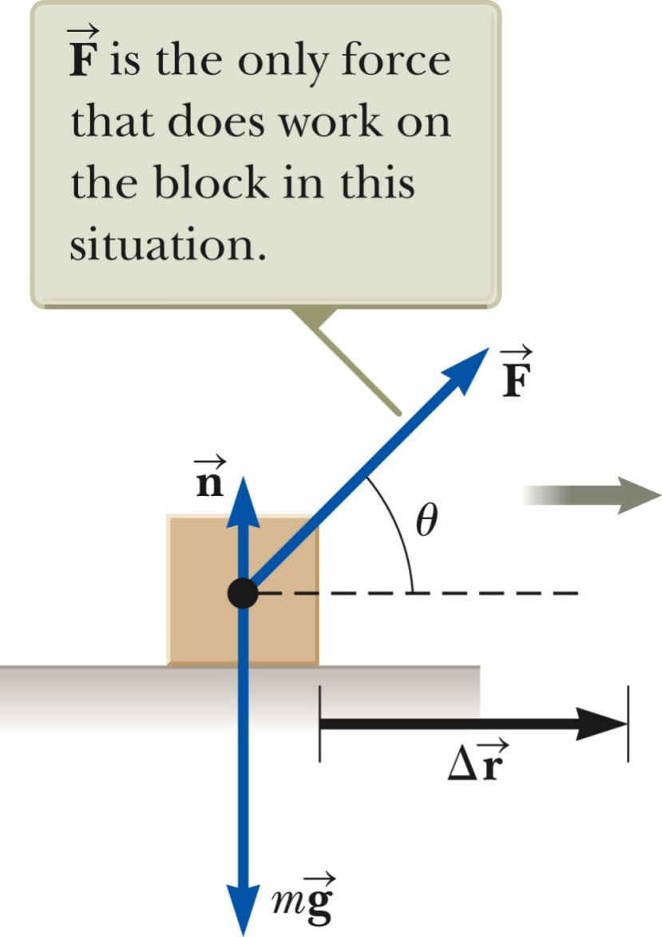

Work Example
The normal force and the gravitational force do no work on the object.
  cos θ = cos 90° = 0
The force is the only force that does work on the object.

Slide 4
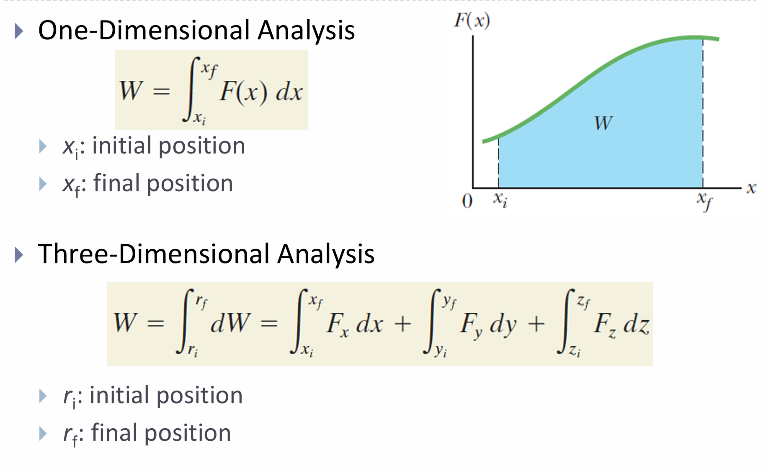

Slide 5
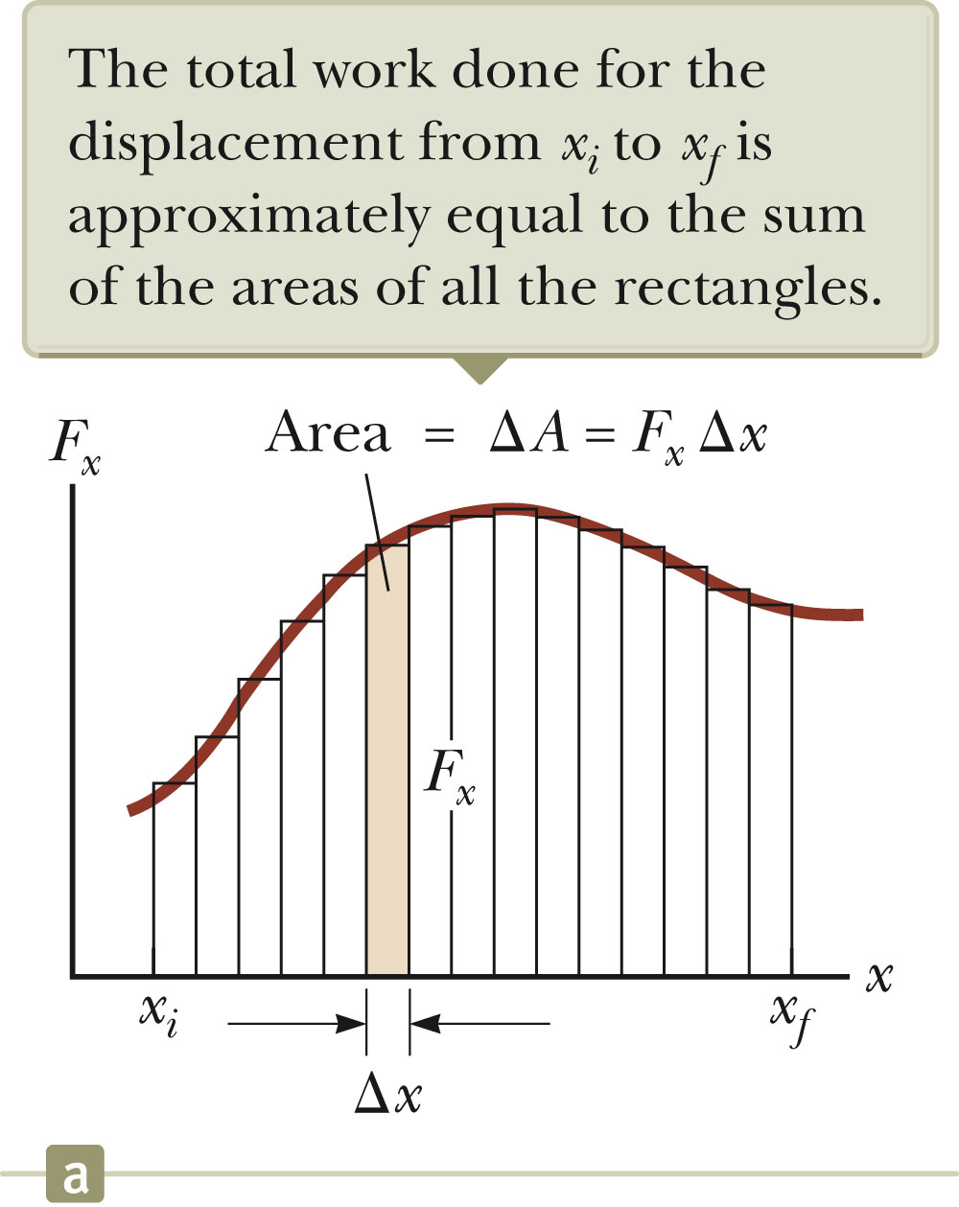
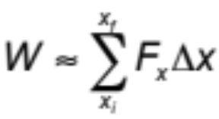
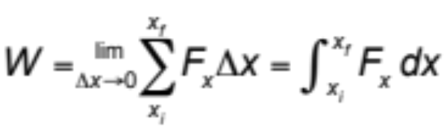
Work Done by a Varying Force
To calculate the work done by a varying force, assume that during a very small displacement, Δx, F is constant.
For that displacement, W ~ F Δx
For all of the intervals,
If Δx ➔ 0
The work done is equal to the area under the curve between x_{i} and x_{f.}

Slide 6
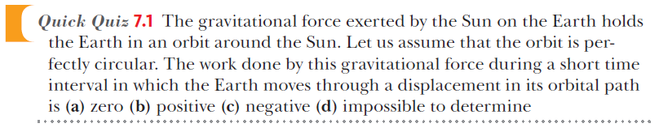
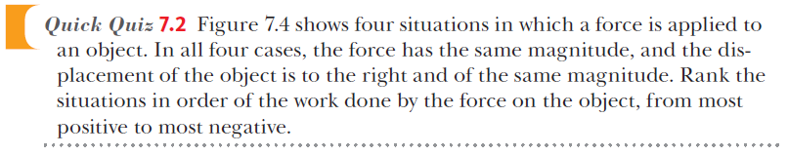
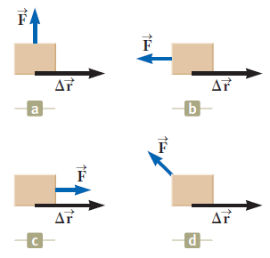

Slide 7
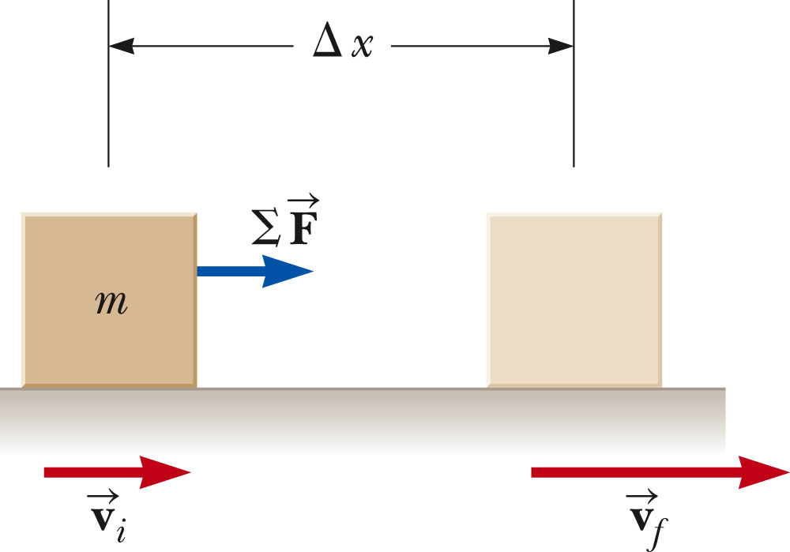
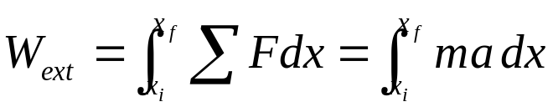
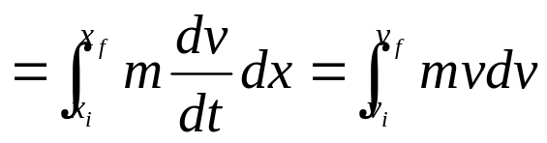
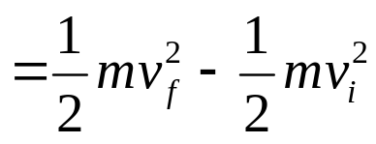

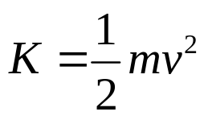
Kinetic Energy, cont
Calculating the work:
where

Slide 8
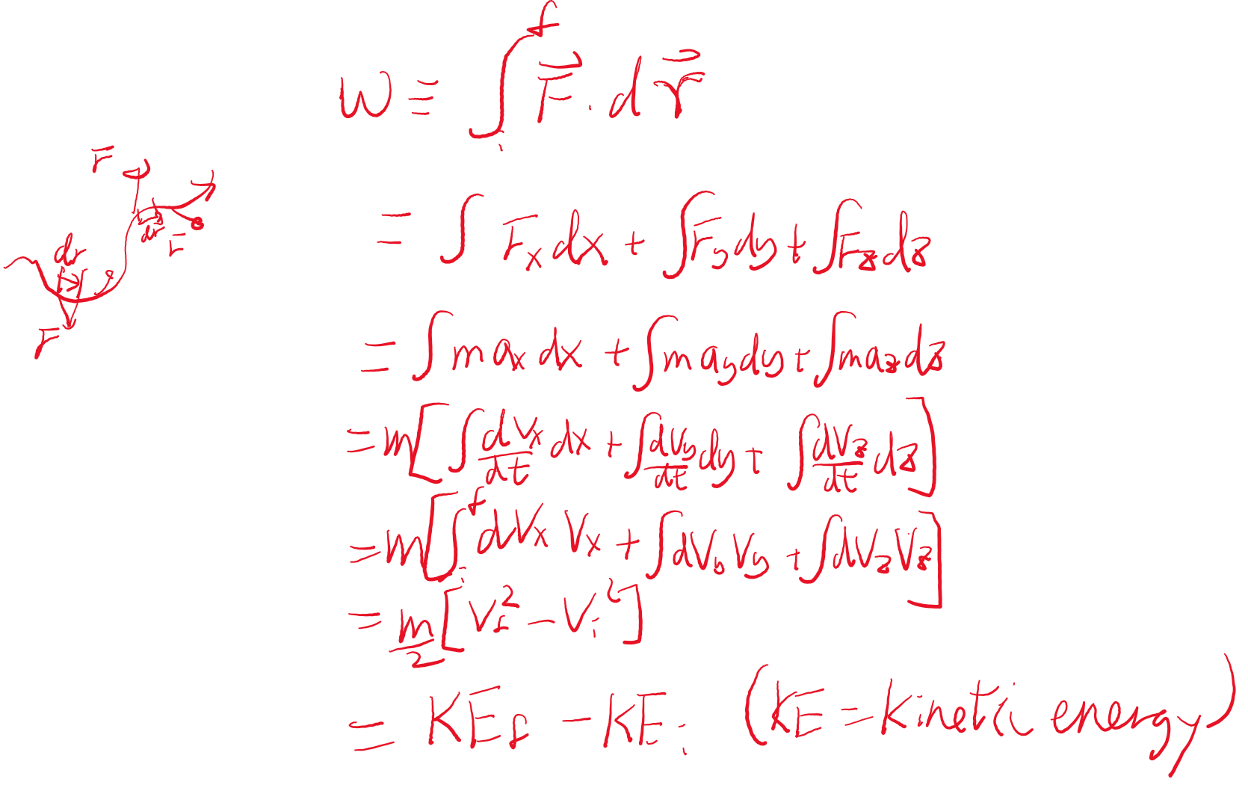

Slide 9

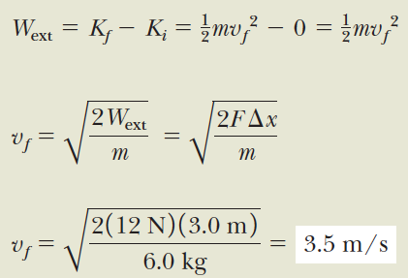
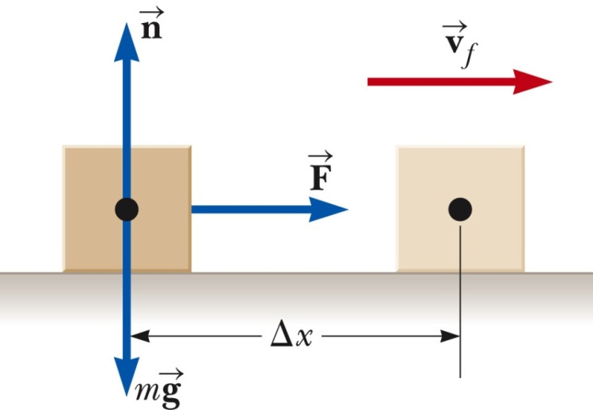


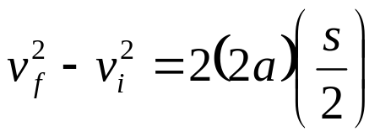

Slide 10
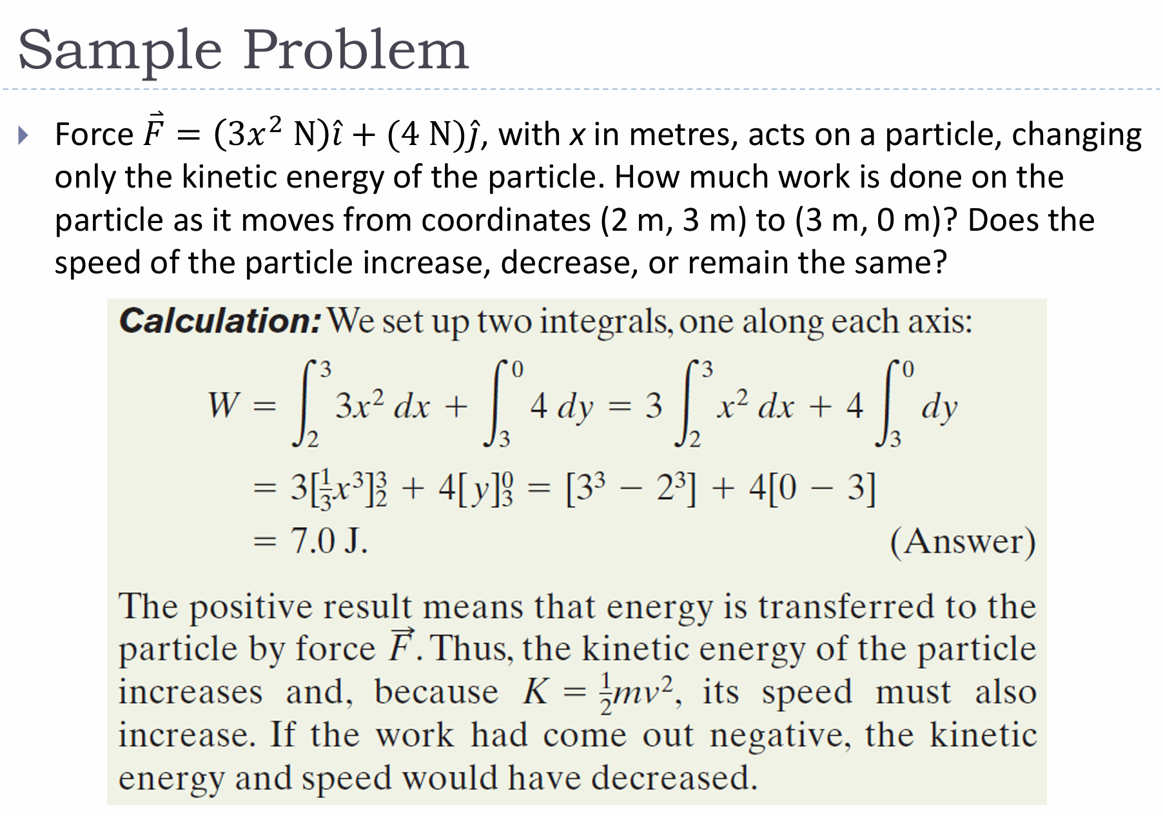

Slide 11
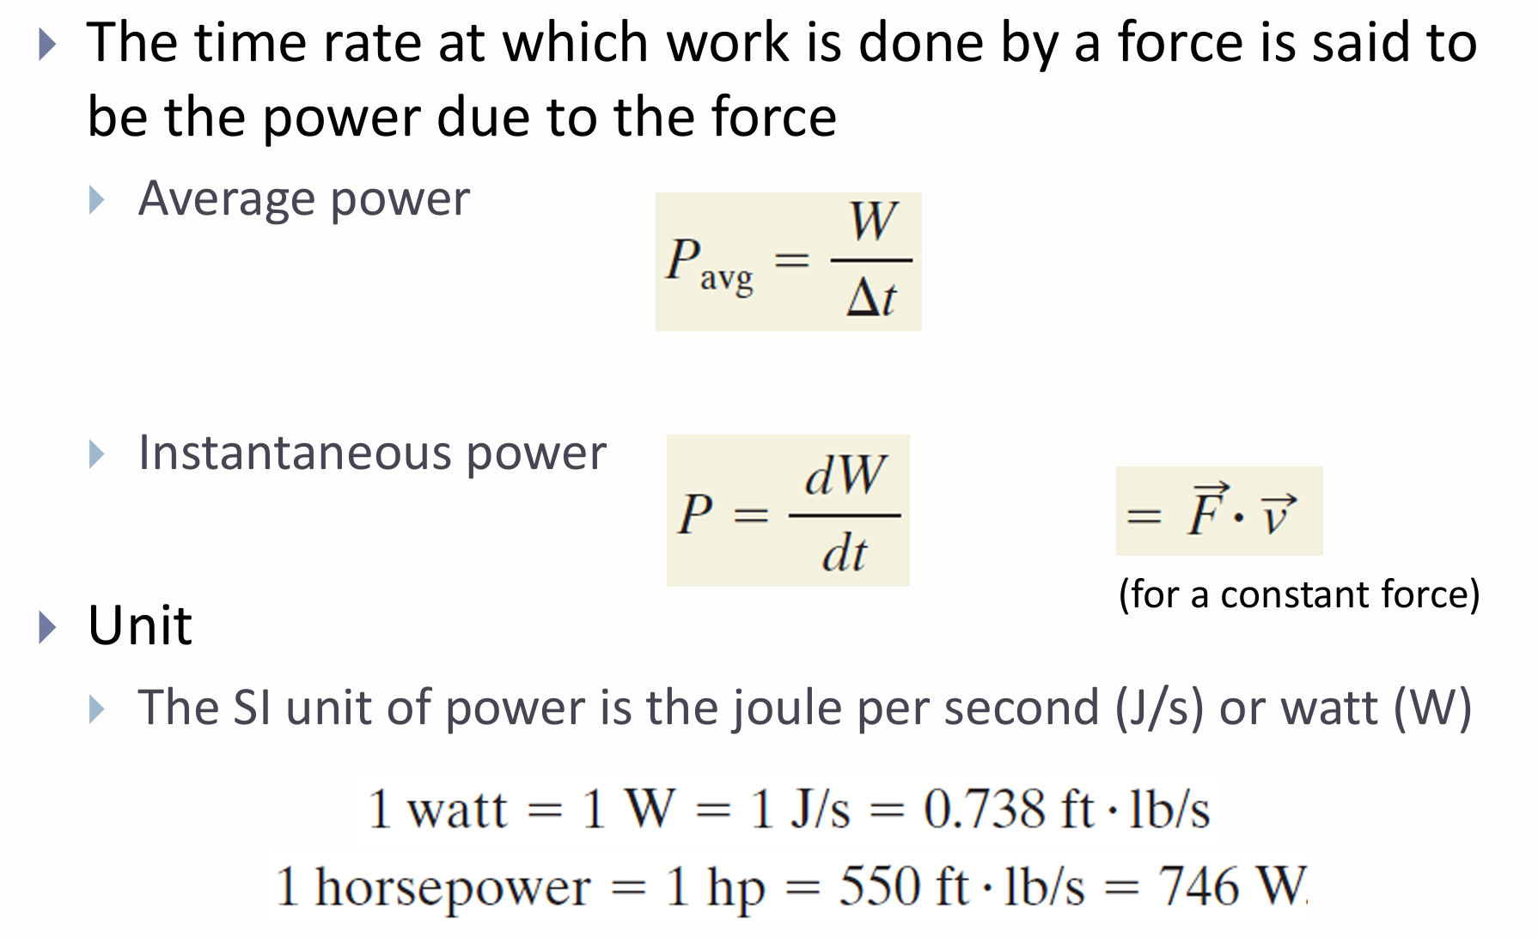
Power

Slide 12
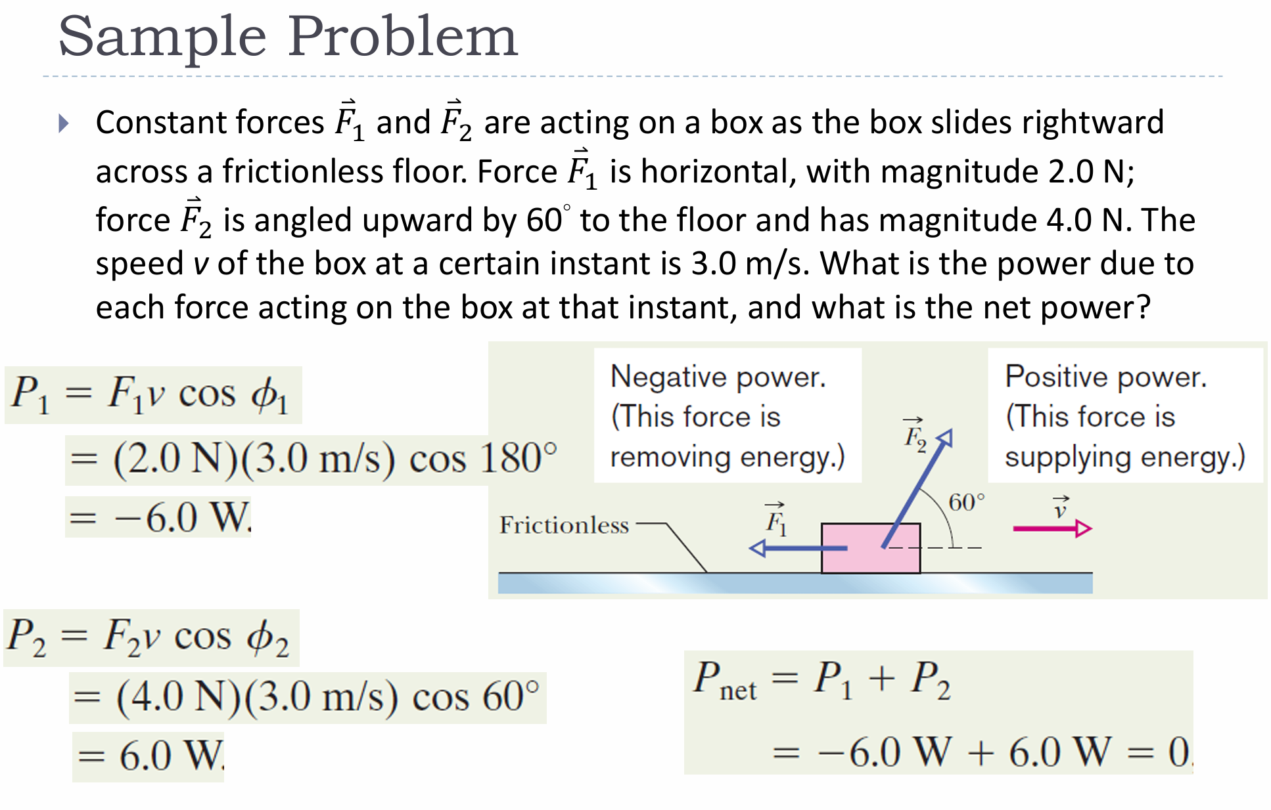

Slide 13
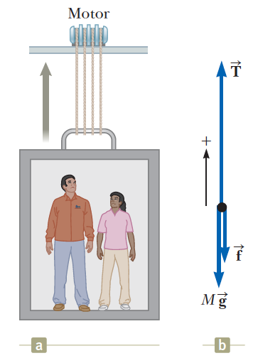
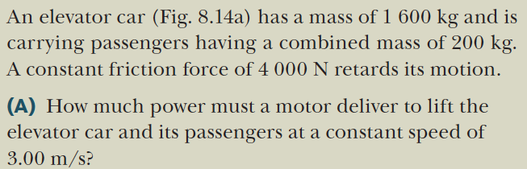
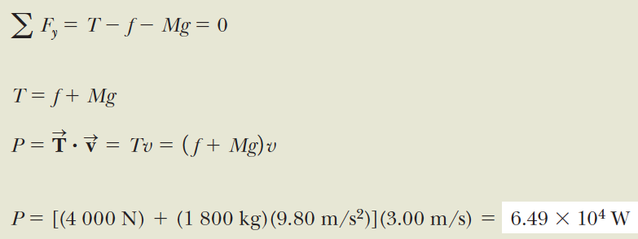
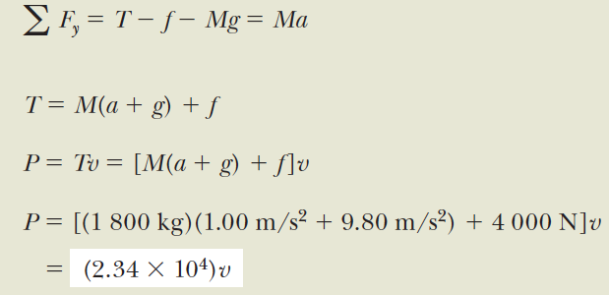

Slide 14
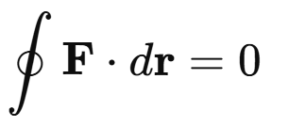
Conservative force and Potential energy
A conservative force is a force for which the work done on an object is independent of the path taken and depends only on the initial and final positions. This means that when an object moves in a closed loop under a conservative force, the net work done is zero.
Path Independence:
The work done by a conservative force only depends on the starting and ending positions, not on the path taken between them.
Work Done in a Closed Path is Zero: If a particle moves in a closed loop, returning to its starting point, the total work done by a conservative force is zero:

Slide 15
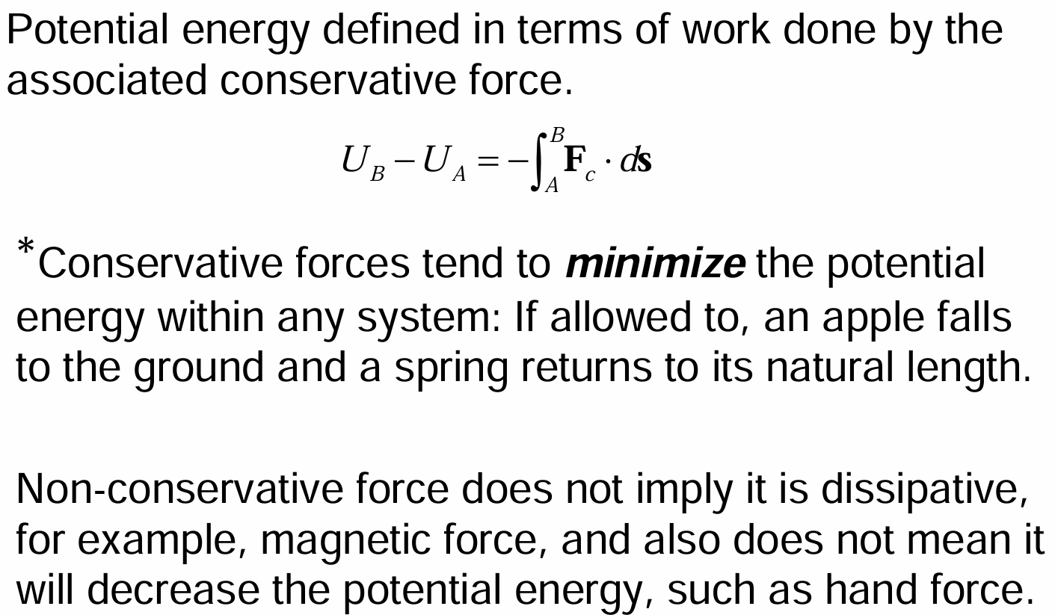
Potential Energy and Conservative Forces

Slide 16
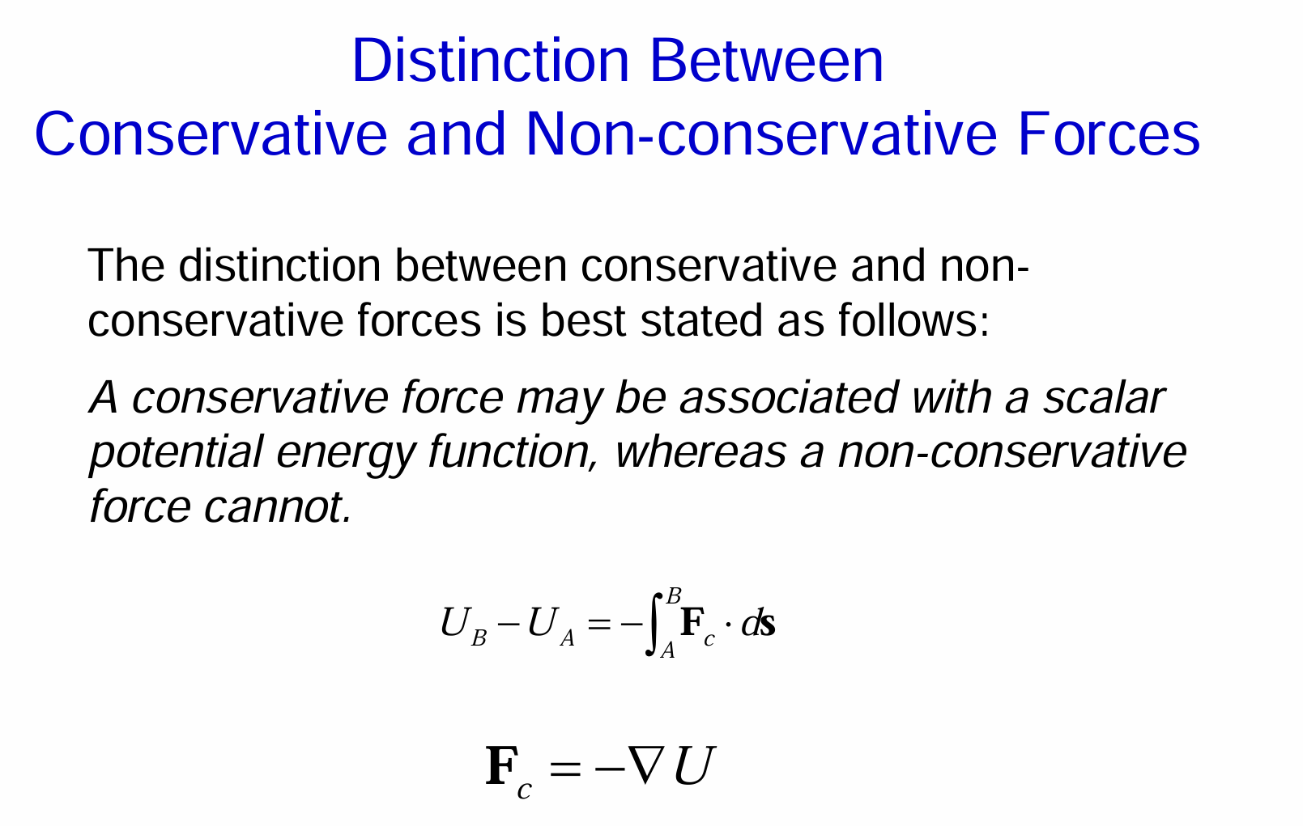

Slide 17






Force and Potential Energy in 3D
When

Slide 18
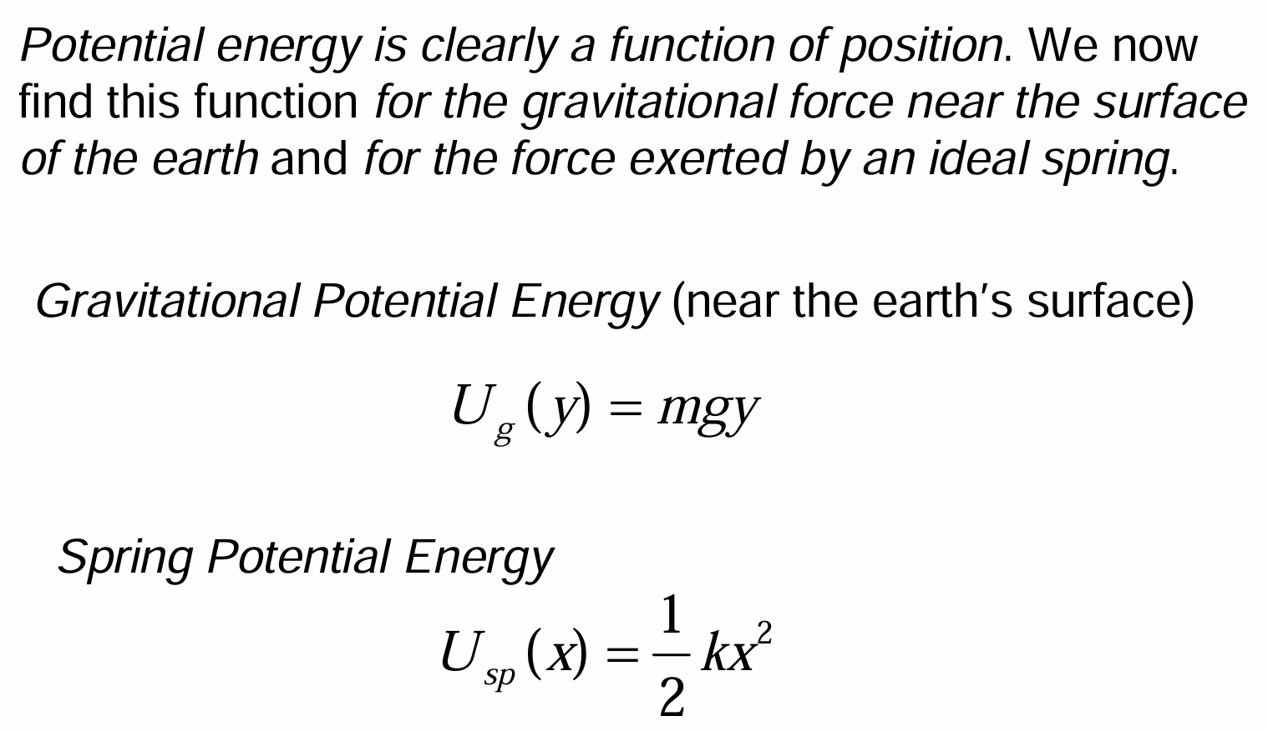
Potential Energy Functions

Slide 19
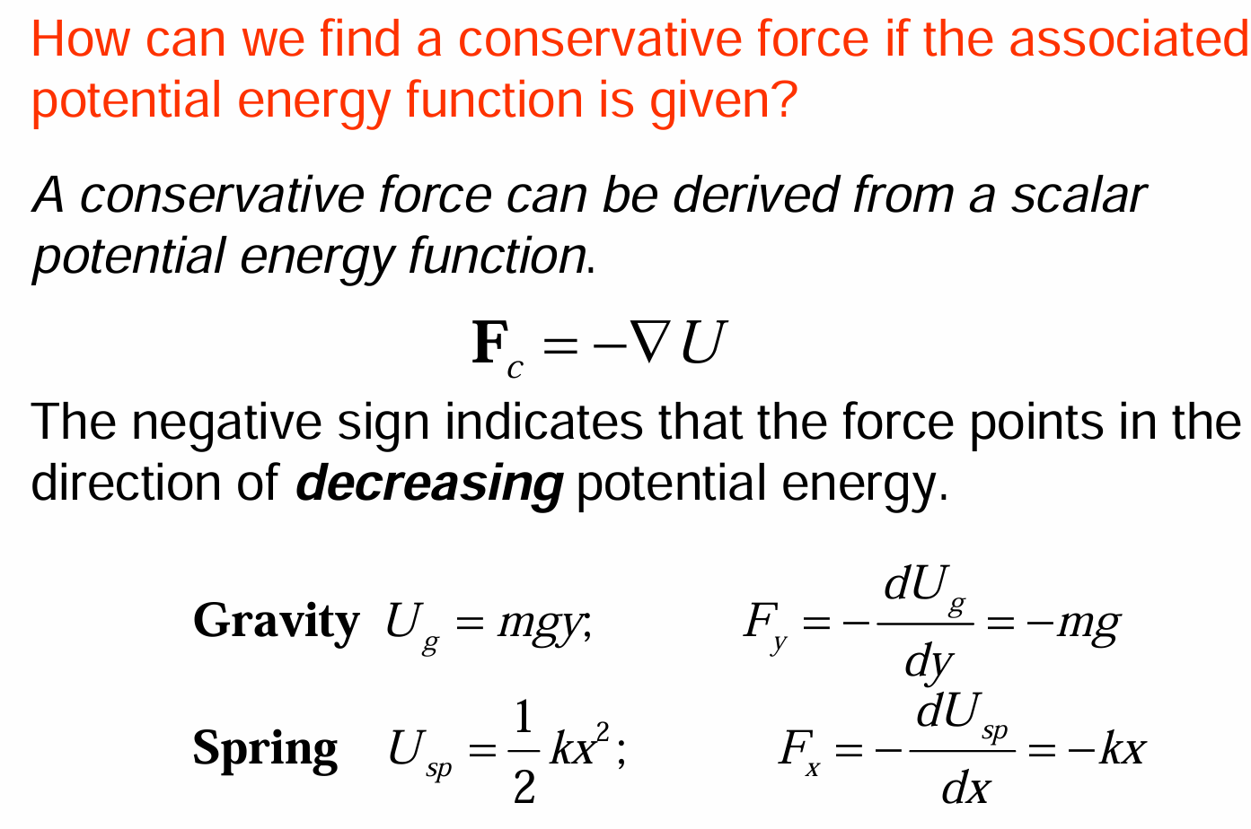

Slide 20
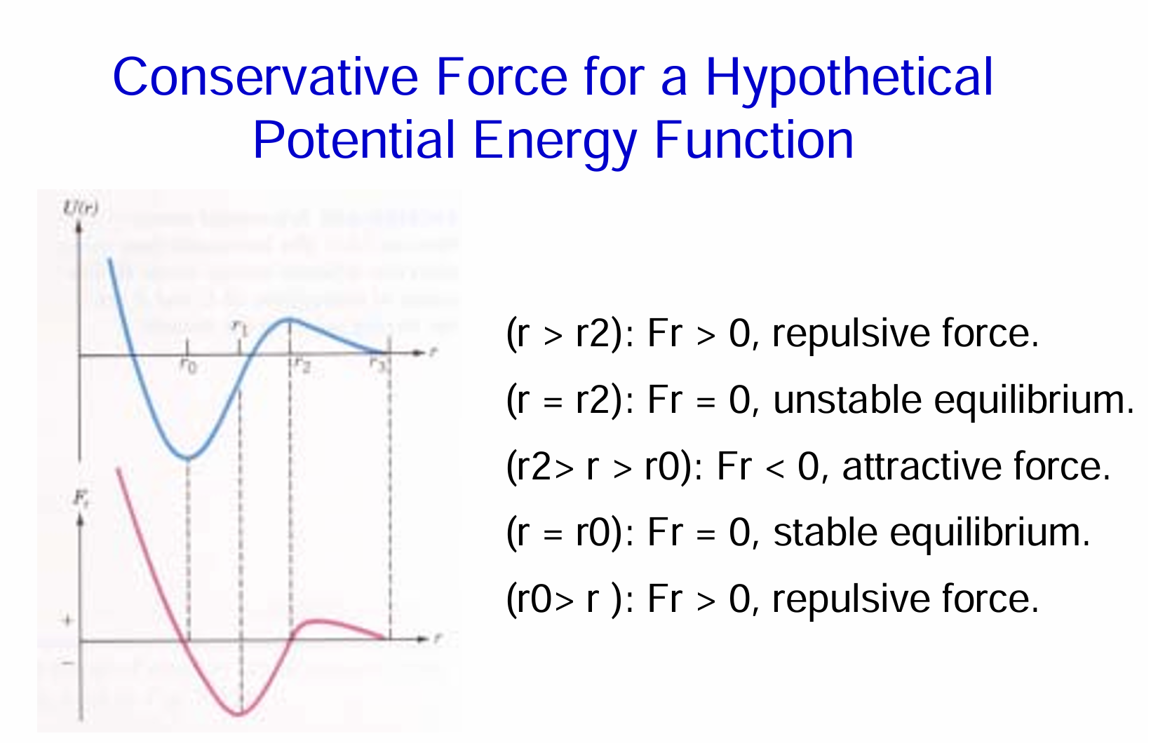

Slide 21
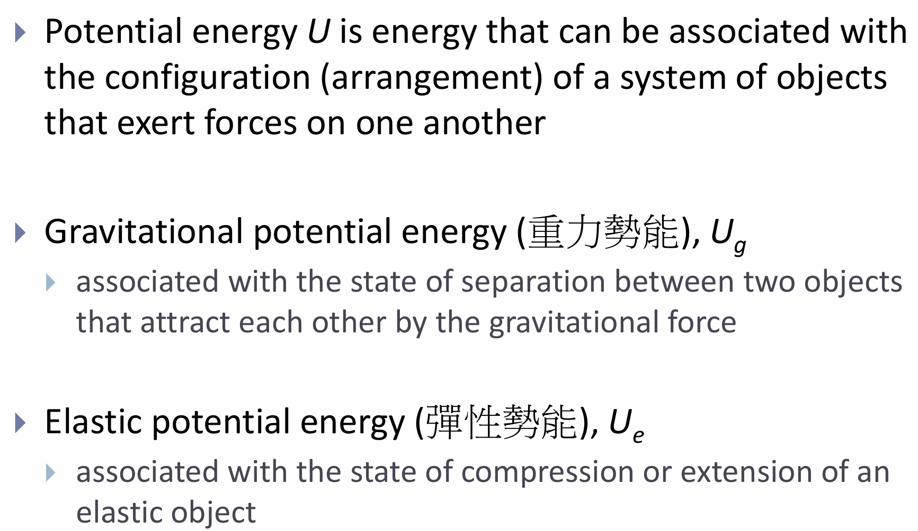
Potential Energy

Slide 22
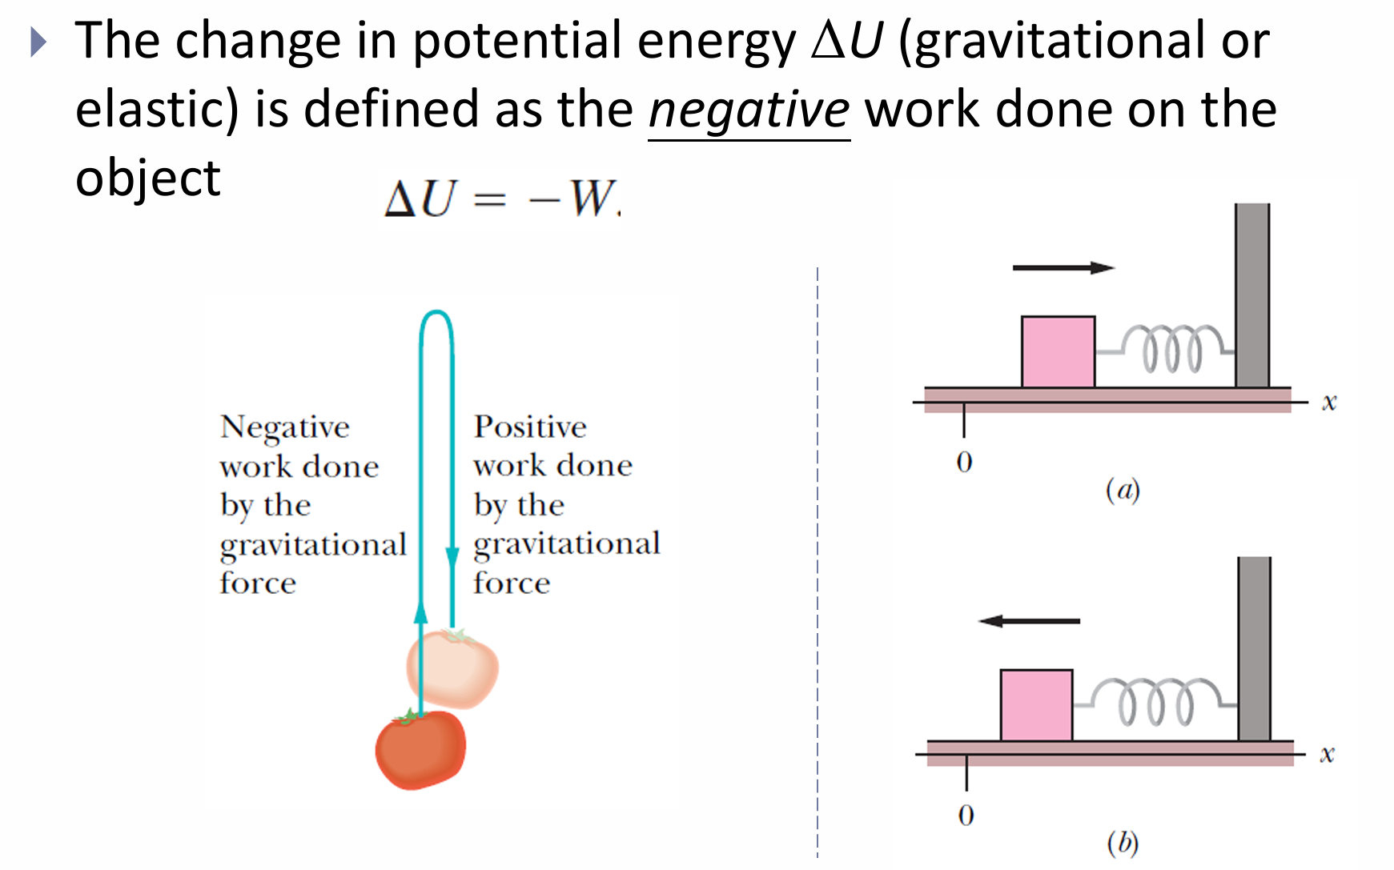
Potential Energy

Slide 23
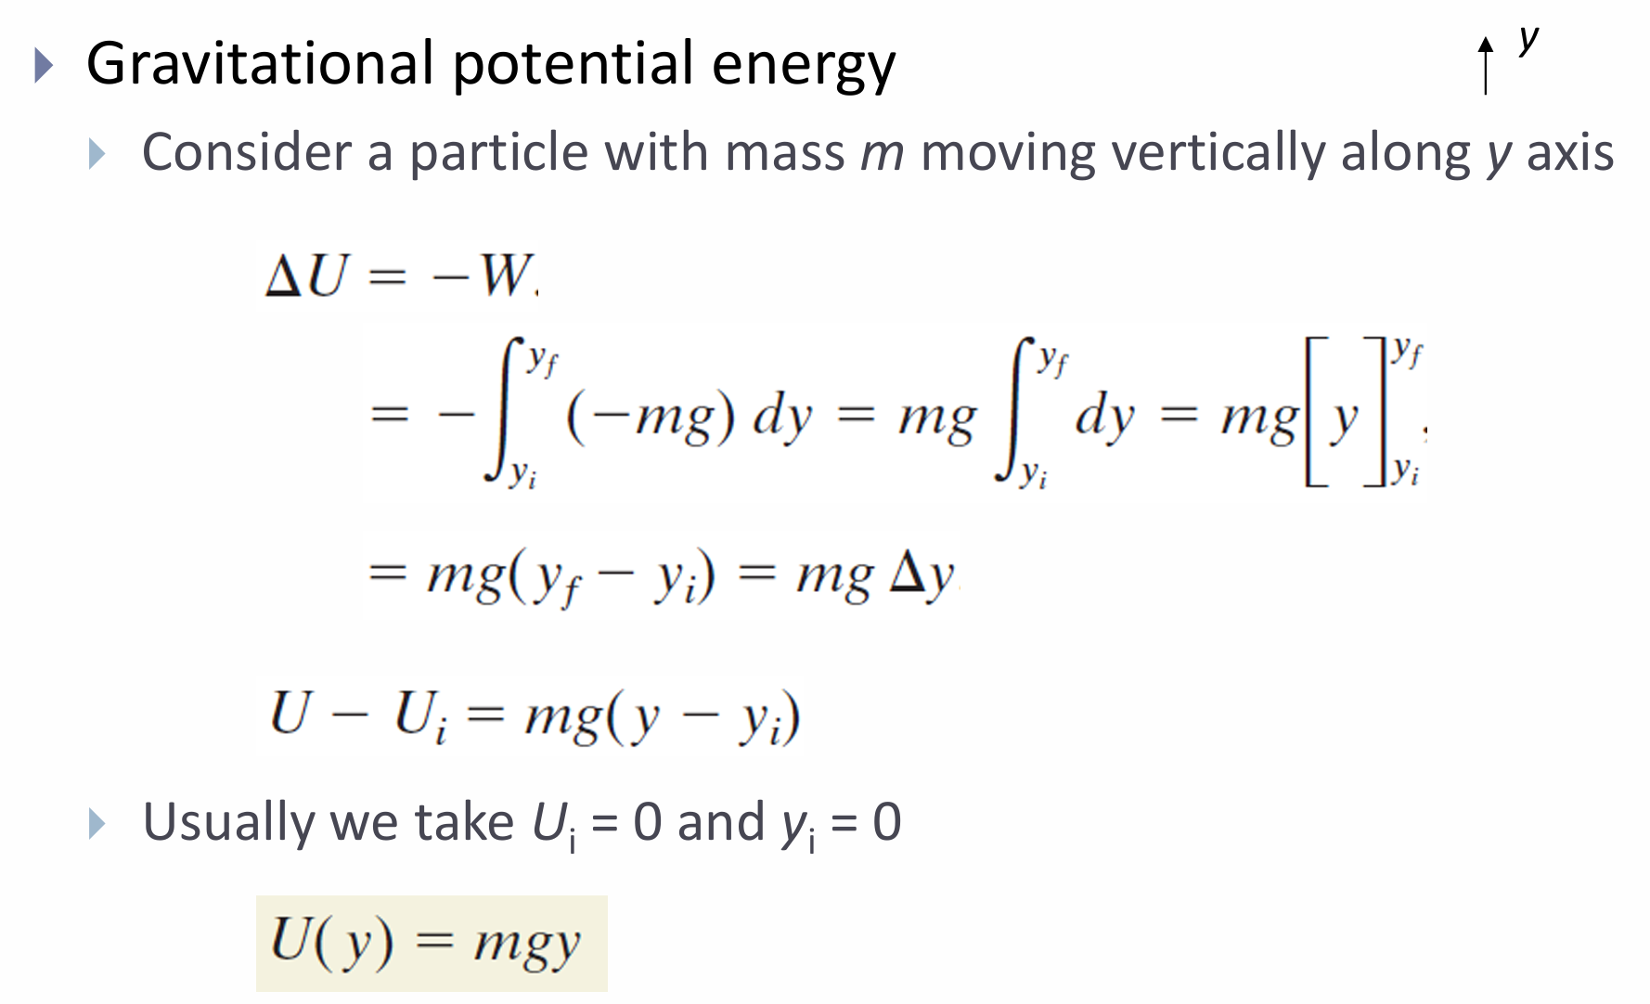

Slide 24

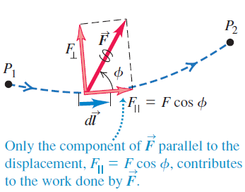

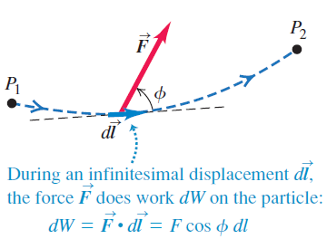
Motion Along a Curve

Slide 25
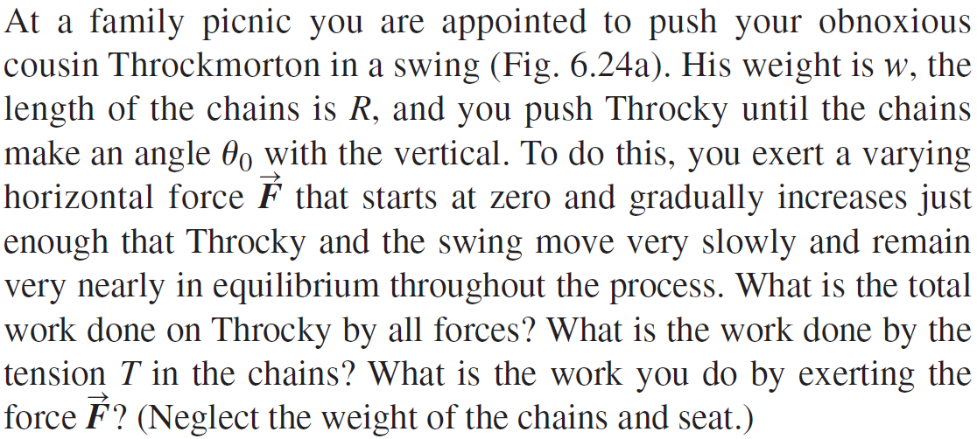
Example 6.8: Motion on a curved path

Slide 26

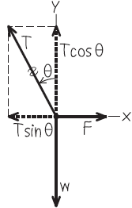

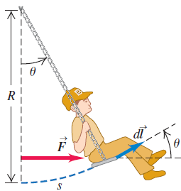
Example 6.8: Motion on a curved path

Slide 27

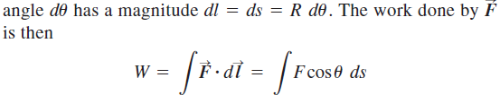
Example 6.8: Motion on a curved path

Slide 28
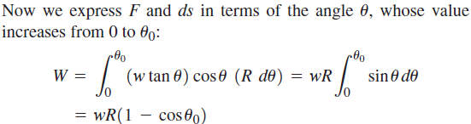
Example 6.8: Motion on a curved path

Slide 29
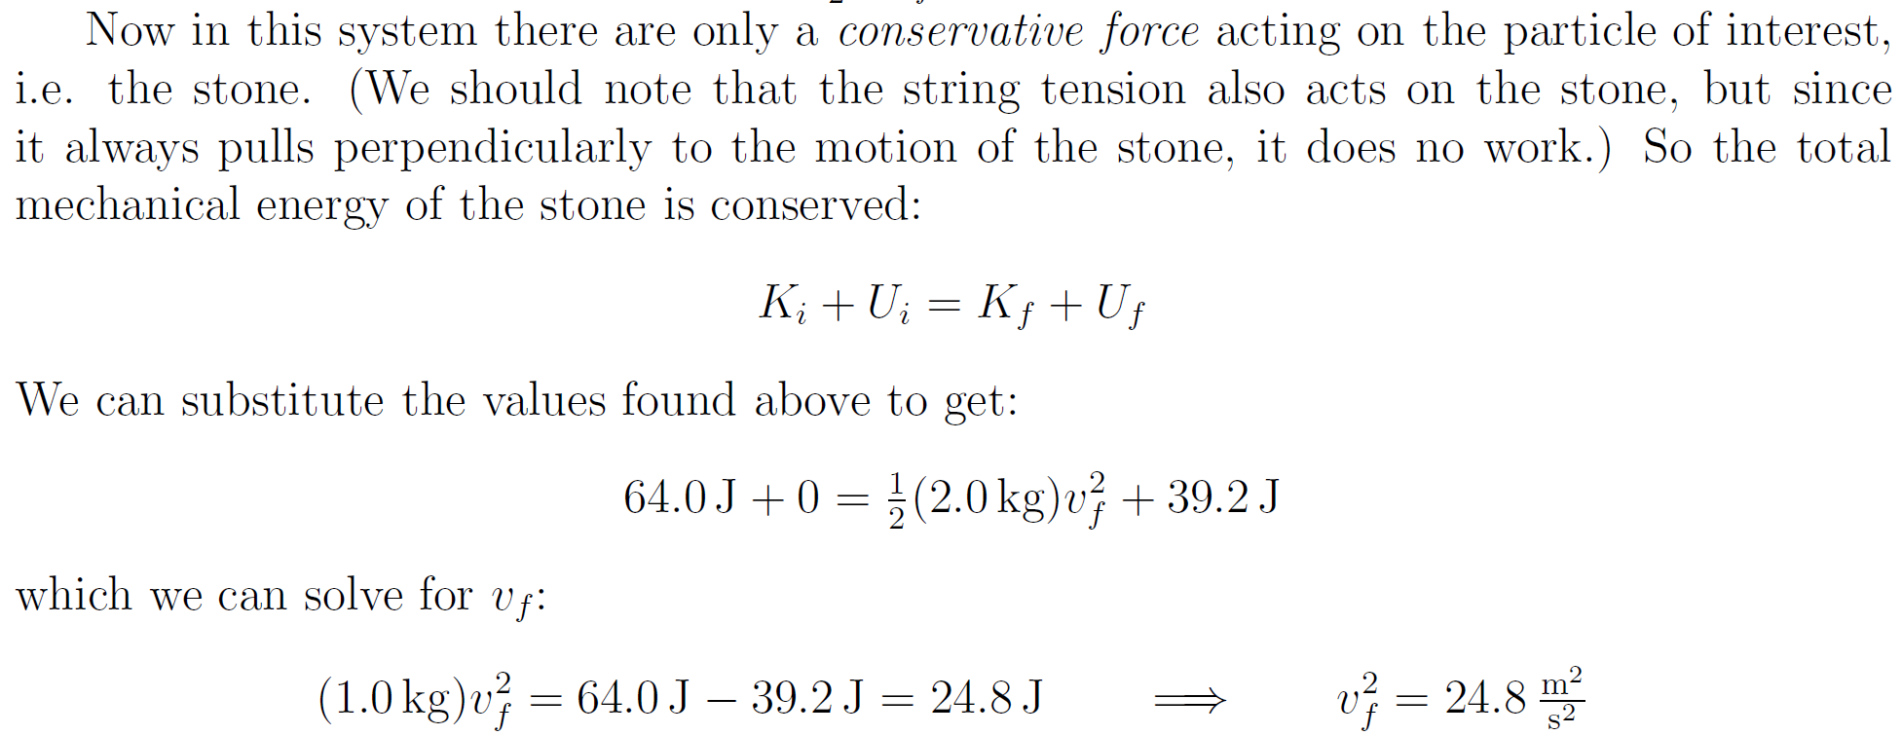
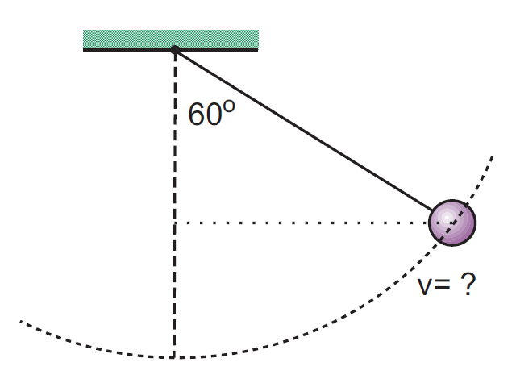
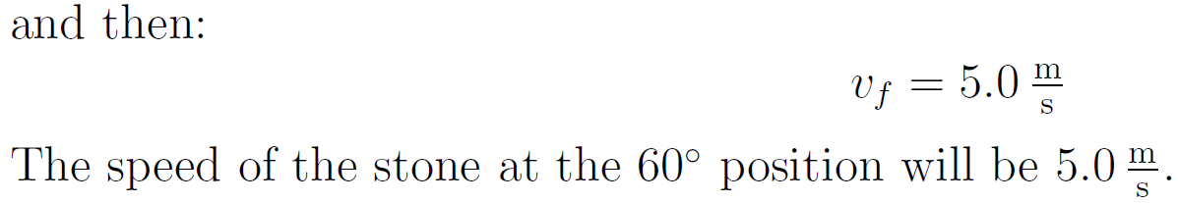

Slide 30
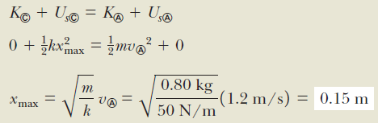
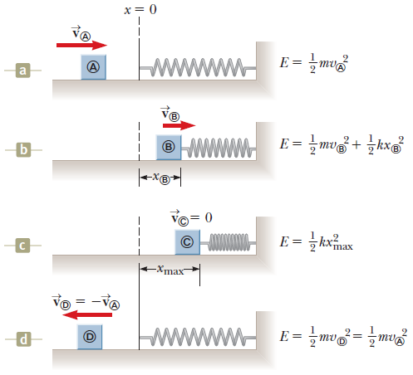

Slide 31

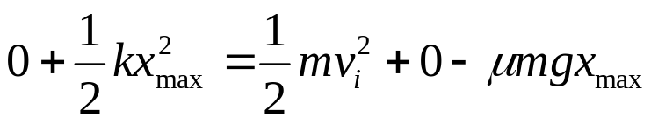
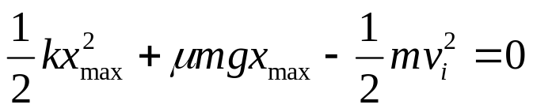
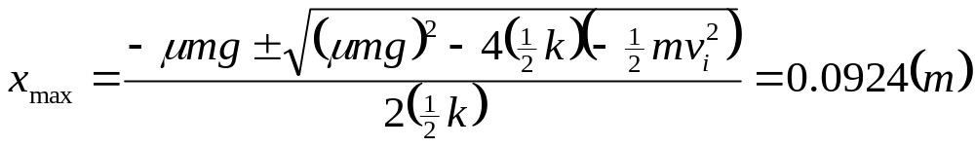
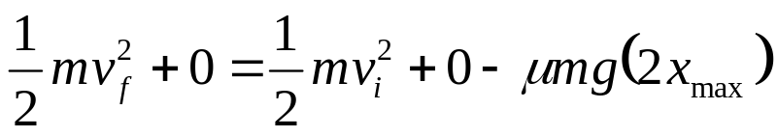

(C) What is the speed of the mass when it just leave the spring, if friction is present?

Slide 32


Potential Energy

Slide 33

Conservation of Mechanical Energy

Slide 34
Potential Energy
Potential energy is energy determined by the configuration of a system in which the components of the system interact by forces.
  The forces are internal to the system.
  Can be associated with only specific types of (conservative) forces acting between members of a system.
    Examples of conservative forces:
      Gravity
      Spring force

Slide 35





Gravitational Potential Energy
The system is the Earth and the book.
Do work on the book by lifting it slowly through a vertical displacement.
The work done on the system must appear as an increase in the energy of the system. The energy storage through this mechanism is called gravitational potential energy.
where
In order to express U explicitly, the reference point (h = 0) has to be defined first.

Slide 36


A child of mass m is released from rest at the top of a water slide, at height h = 8.5 m above the bottom of the slide. Assuming that the slide is frictionless because of the water on it, find the child’s speed at the bottom of the slide.

Slide 37




Slide 38




Section 8.2

Slide 39





Slide 40



Slide 41


Slide 42










Slide 43




Slide 44



Slide 46
(C) What is the speed of the mass when it just leave the spring, if friction is present?

Slide 47

Work Done on a System by an External Force

Slide 48


Slide 49

Conservation of Energy

Slide 50


Slide 51


Slide 52


Slide 53





Slide 54





Example 6.6: Work done on a spring scale

Slide 55







